Slide 1


Computer Networks
Lectures (Chapter3)
Transport Layer
Subhan Ullah, PhD
subhan.ullah@nu.edu.pk
BS(Computer Science) Fall-2022

Slide 2
Transport layer: overview
Our goal:
understand principles behind transport layer services:
multiplexing, demultiplexing
reliable data transfer
flow control
congestion control
learn about Internet transport layer protocols:
UDP: connectionless transport
TCP: connection-oriented reliable transport
TCP congestion control

Slide 3

Transport layer: roadmap
Transport-layer services
Multiplexing and demultiplexing
Connectionless transport: UDP
Principles of reliable data transfer
Connection-oriented transport: TCP
Principles of congestion control
TCP congestion control
Evolution of transport-layer functionality

Slide 4
Chapter 3: roadmap
Transport-layer services
Multiplexing and demultiplexing
Connectionless transport: UDP
Principles of reliable data transfer
Connection-oriented transport: TCP
segment structure
reliable data transfer
flow control
connection management
Principles of congestion control
TCP congestion control

Slide 5
Chapter 3: roadmap
Transport-layer services
Multiplexing and demultiplexing
Connectionless transport: UDP
Principles of reliable data transfer
Connection-oriented transport: TCP
Principles of congestion control
TCP congestion control
Evolution of transport-layer functionality
Notes:
D topic covered: date: 25/11/2021

Slide 6
Chapter 3: roadmap
Transport-layer services
Multiplexing and demultiplexing
Connectionless transport: UDP
Principles of reliable data transfer
Connection-oriented transport: TCP
Principles of congestion control
TCP congestion control
Evolution of transport-layer functionality

Slide 7
TCP congestion control: AIMD
approach: senders can increase sending rate until packet loss (congestion) occurs, then decrease sending rate on loss event
Additive Increase
Multiplicative Decrease
increase sending rate by 1 maximum segment size every RTT until loss detected
cut sending rate in half at each loss event
AIMD sawtooth
behavior: probing
for bandwidth
TCP sender Sending rate
time
Notes:
E covered:

Slide 8
TCP AIMD: more detail
Multiplicative decrease detail: sending rate is
Cut in half on loss detected by triple duplicate ACK (TCP Reno)
Cut to 1 MSS (maximum segment size) when loss detected by timeout (TCP Tahoe)
Why AIMD?
AIMD – a distributed, asynchronous algorithm – has been shown to:
optimize congested flow rates network wide!
have desirable stability properties

Slide 9
TCP congestion control: details
sender sequence number space
TCP sending behavior:
roughly: send cwnd bytes, wait RTT for ACKS, then send more bytes
cwnd
last byte
ACKed
cwnd
sent, but not-yet ACKed
(“in-flight”)
available but not used
TCP rate
~
bytes/sec
~
RTT
last byte sent
TCP sender limits transmission:
cwnd is dynamically adjusted in response to observed network congestion (implementing TCP congestion control)
<
cwnd
LastByteSent- LastByteAcked

Slide 10

TCP slow start
Host A
Host B
when connection begins, increase rate exponentially until first loss event:
initially cwnd = 1 MSS
double cwnd every RTT
done by incrementing cwnd for every ACK received
one segment
RTT
two segments
four segments
summary: initial rate is slow, but ramps up exponentially fast
time

Slide 11
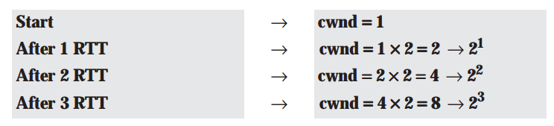
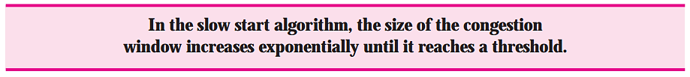
TCP Slow Start (more detail)
If we look at the size of the cwnd in terms of round-trip times (RTTs), we find that the growth rate is exponential as shown below:
Notes:
Slow start cannot continue indefinitely. There must be a threshold to stop this phase.
The sender keeps track of a variable named ssthresh (slow start threshold). When the size of window in bytes reaches this threshold, slow start stops and the next phase starts.

Slide 12
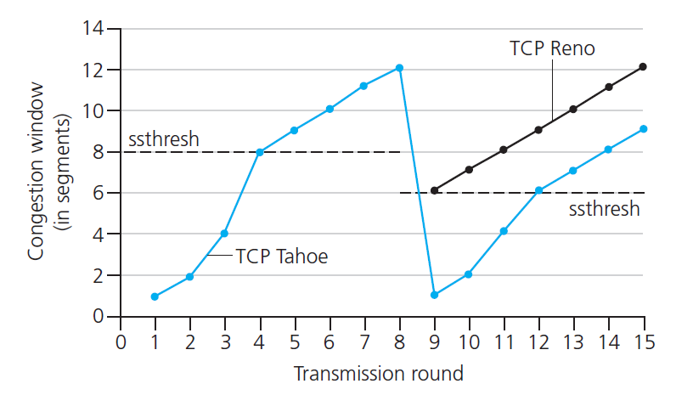

TCP: from slow start to congestion avoidance
Q: when should the exponential increase switch to linear?
A: when cwnd gets to 1/2 of its value before timeout.
X
Implementation:
variable ssthresh
on loss event, ssthresh is set to 1/2 of cwnd just before loss event

Slide 13
Summary: TCP Congestion Control
When cwnd is below ssthresh, sender in slow-start phase, window grows exponentially.
When cwnd is above ssthresh, sender is in congestion-avoidance phase, window grows linearly
When a triple duplicate ACK occurs, ssthresh set to cwnd/2 and cwnd set to ssthresh+3
When timeout occurs, ssthresh set to cwnd/2 and cwnd is set to 1 MSS

Slide 14


Summary: TCP congestion control
New
ACK!
New
ACK!
.
duplicate ACK
new ACK
dupACKcount++
new ACK
cwnd = cwnd + MSS (MSS/cwnd)
dupACKcount = 0
transmit new segment(s), as allowed
cwnd = cwnd+MSS
dupACKcount = 0
transmit new segment(s), as allowed
Λ
cwnd = 1 MSS
ssthresh = 64 KB
dupACKcount = 0
cwnd > ssthresh
slow
start
Λ
congestion
avoidance
timeout
ssthresh = cwnd/2
cwnd = 1 MSS
dupACKcount = 0
retransmit missing segment
duplicate ACK
timeout
dupACKcount++
ssthresh = cwnd/2
cwnd = 1 MSS
dupACKcount = 0
retransmit missing segment
timeout
New
ACK!
ssthresh = cwnd/2
cwnd = 1 MSS
dupACKcount = 0
retransmit missing segment
New ACK
dupACKcount == 3
cwnd = ssthresh
dupACKcount = 0
dupACKcount == 3
ssthresh= cwnd/2
cwnd = ssthresh + 3
retransmit missing segment
ssthresh= cwnd/2
cwnd = ssthresh + 3
retransmit missing segment
fast
recovery
duplicate ACK
cwnd = cwnd + MSS
transmit new segment(s), as allowed

Slide 15
When does the Slow Start end?
First, if there is a loss event (i.e., congestion) indicated by a timeout,
TCP sender sets the value of cwnd to 1, restart Slow Start
ssthresh variable (“slow start threshold”) to cwnd/2
The second way in which slow start may end is directly tied to the value of ssthresh
When cwnd equals ssthresh, slow start ends and TCP transitions into congestion avoidance mode
Why not keep doubling?
The final way in which slow start can end is if three duplicate ACKs are detected,
TCP performs a fast retransmit and enters the fast recovery state

Slide 16
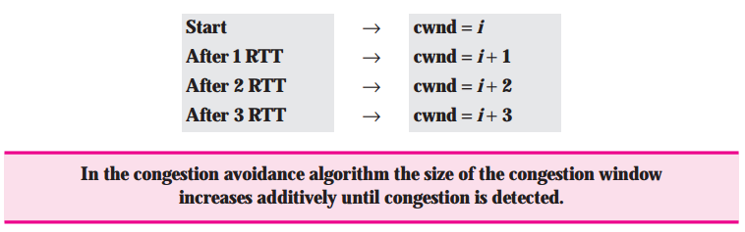
TCP Congestion Control - Congestion Avoidance
When do we get to this state
value of cwnd is approximately half its value when congestion was last encountered
congestion could be just around the corner!
Rather than doubling the value of cwnd every RTT, TCP adopts a more conservative approach and increases the value of cwnd by just a single MSS every RTT
Notes:
This can be accomplished in several ways.
TCP sender increases cwnd by MSS bytes (MSS/cwnd) when- ever a new acknowledgment arrives.
For example, if MSS is 1,460 bytes and cwnd is 14,600 bytes, then 10 segments are being sent within an RTT.
Each arriving ACK (assuming one ACK per segment) increases the congestion window size by 1/10 MSS (146 bytes).

Slide 17
Slow start with Congestion avoidance
When does it end?
TCP’s congestion-avoidance algorithm behaves the same when a timeout occurs
On time out: Congestion avoidance
Set ssthresh = cwnd/2 ; cwnd =1
Drawback
Slow recovery from losses
Timeout drain the pipe -> Forces one to do slow start which takes time to fill the pipe

Slide 18
TCP Congestion Control - Fast Recovery
When do we get to this state?
loss event also can be triggered by a triple duplicate ACK event
In this case, the network is continuing to deliver segments from sender to receiver
So TCP’s behavior to this type of loss event should be less drastic than with a timeout-indicated loss
Idea: each dup ACK represents a packet successfully received. Therefore, no need for very drastic action

Slide 19
TCP Congestion Control - Fast Recovery
What does TCP do?
TCP halves the value of cwnd (adding in 3 MSS)
ssthresh half the value of cwnd
cwnd is increased by 1 MSS for every duplicate ACK received for the missing segment that caused TCP to enter the fast-recovery state.
set SSThresh = CWND/2
set CWND = SSThresh + 3

Slide 20
TCP Congestion Control - Fast Recovery
When does it end?
when an ACK arrives for the missing segment, TCP enters the congestion-avoidance state.
If a timeout event occurs, fast recovery transitions to the slow-start state
Generally, fast retransmit eliminates about half the coarse-grain timeouts.
This yields roughly a 20% improvement in throughput

Slide 21
TCP Congestion Control - Fast Recovery
Fast recovery is a recommended, but not required, component of TCP
Early version of TCP, TCP Tahoe, unconditionally cut its congestion window to 1 MSS.
The newer version of TCP, TCP Reno, incorporated fast recovery.

Slide 22
TCP CUBIC
Is there a better way than AIMD to “probe” for usable bandwidth?
Insight/intuition:
W_{max}: sending rate at which congestion loss was detected
congestion state of bottleneck link probably (?) hasn’t changed much
after cutting rate/window in half on loss, initially ramp to to W_{max} faster, but then approach W_{max} more slowly
W_{max}
classic TCP
TCP CUBIC - higher throughput in this example
W_{max}/2

Slide 23
TCP CUBIC
K: point in time when TCP window size will reach W_{max}
K itself is tuneable
increase W as a function of the cube of the distance between current time and K
larger increases when further away from K
smaller increases (cautious) when nearer K
TCP CUBIC default in Linux, most popular TCP for popular Web servers
W_{max}
TCP Reno
TCP CUBIC
TCP
sending
rate
time
t₀
t₁
t₂
t₃
t₄

Slide 24
TCP and the congested “bottleneck link”
TCP (classic, CUBIC) increase TCP’s sending rate until packet loss occurs at some router’s output: the bottleneck link
source
destination
application
TCP
network
link
physical
application
TCP
network
link
physical
packet queue almost never empty, sometimes overflows packet (loss)
bottleneck link (almost always busy)

Slide 25
TCP and the congested “bottleneck link”
TCP (classic, CUBIC) increase TCP’s sending rate until packet loss occurs at some router’s output: the bottleneck link
understanding congestion: useful to focus on congested bottleneck link
insight: increasing TCP sending rate will not increase end-end throughout with congested bottleneck
source
destination
application
TCP
network
link
physical
application
TCP
network
link
physical
insight: increasing TCP sending rate will increase measured RTT
Goal: “keep the end-end pipe just full, but not fuller”
RTT

Slide 26
Delay-based TCP congestion control
Keeping sender-to-receiver pipe “just full enough, but no fuller”: keep bottleneck link busy transmitting, but avoid high delays/buffering
# bytes sent in last RTT interval
RTT_{measured}
measured
throughput
=
RTT_{measured}
Delay-based approach:
RTT_{min} - minimum observed RTT (uncongested path)
uncongested throughput with congestion window cwnd is cwnd/RTT_{min}
if measured throughput “very close” to uncongested throughput
increase cwnd linearly /* since path not congested */
else if measured throughput “far below” uncongested throughout
decrease cwnd linearly /* since path is congested */

Slide 27
Delay-based TCP congestion control
congestion control without inducing/forcing loss
maximizing throughout (“keeping the just pipe full… ”) while keeping delay low (“…but not fuller”)
a number of deployed TCPs take a delay-based approach
BBR deployed on Google’s (internal) backbone network

Slide 28
Explicit congestion notification (ECN)
TCP deployments often implement network-assisted congestion control:
two bits in IP header (ToS field) marked by network router to indicate congestion
policy to determine marking chosen by network operator
congestion indication carried to destination
destination sets ECE bit on ACK segment to notify sender of congestion
involves both IP (IP header ECN bit marking) and TCP (TCP header C,E bit marking)
source
TCP ACK segment
destination
application
TCP
network
link
physical
application
TCP
network
link
physical
ECE=1
ECN=10
ECN=11
IP datagram

Slide 29
TCP fairness
Fairness goal: if K TCP sessions share same bottleneck link of bandwidth R, each should have average rate of R/K
TCP connection 1
bottleneck
router
capacity R
TCP connection 2

Slide 30
Q: is TCP Fair?
Example: two competing TCP sessions:
additive increase gives slope of 1, as throughout increases
multiplicative decrease decreases throughput proportionally
R
equal bandwidth share
Is TCP fair?
A: Yes, under idealized assumptions:
same RTT
fixed number of sessions only in congestion avoidance
loss: decrease window by factor of 2
congestion avoidance: additive increase
Connection 2 throughput
loss: decrease window by factor of 2
congestion avoidance: additive increase
Connection 1 throughput
R

Slide 31
Fairness: must all network apps be “fair”?
Fairness and UDP
multimedia apps often do not use TCP
do not want rate throttled by congestion control
instead use UDP:
send audio/video at constant rate, tolerate packet loss
there is no “Internet police” policing use of congestion control
Fairness, parallel TCP connections
application can open multiple parallel connections between two hosts
web browsers do this , e.g., link of rate R with 9 existing connections:
new app asks for 1 TCP, gets rate R/10
new app asks for 11 TCPs, gets R/2

Slide 32
Transport layer: roadmap
Transport-layer services
Multiplexing and demultiplexing
Connectionless transport: UDP
Principles of reliable data transfer
Connection-oriented transport: TCP
Principles of congestion control
TCP congestion control
Evolution of transport-layer functionality

Slide 33
Evolving transport-layer functionality
TCP, UDP: principal transport protocols for 40 years
different “flavors” of TCP developed, for specific scenarios:
Scenario | Challenges
Long, fat pipes (large data transfers) | Many packets “in flight”; loss shuts down pipeline
Wireless networks | Loss due to noisy wireless links, mobility; TCP treat this as congestion loss
Long-delay links | Extremely long RTTs
Data center networks | Latency sensitive
Background traffic flows | Low priority, “background” TCP flows
moving transport–layer functions to application layer, on top of UDP
HTTP/3: QUIC

Slide 34
QUIC: Quick UDP Internet Connections
application-layer protocol, on top of UDP
increase performance of HTTP
deployed on many Google servers, apps (Chrome, mobile YouTube app)
HTTP/2
HTTP/2 (slimmed)
Application
HTTP/3
TLS
QUIC
Transport
TCP
UDP
Network
IP
IP
HTTP/2 over TCP
HTTP/2 over QUIC over UDP

Slide 35
QUIC: Quick UDP Internet Connections
adopts approaches we’ve studied in this chapter for connection establishment, error control, congestion control
error and congestion control: “Readers familiar with TCP’s loss detection and congestion control will find algorithms here that parallel well-known TCP ones.” [from QUIC specification]
connection establishment: reliability, congestion control, authentication, encryption, state established in one RTT
multiple application-level “streams” multiplexed over single QUIC connection
separate reliable data transfer, security
common congestion control

Slide 36
QUIC: Connection establishment
TCP handshake
(transport layer)
QUIC handshake
data
TLS handshake
(security)
data
TCP (reliability, congestion control state) + TLS (authentication, crypto state)
2 serial handshakes
QUIC: reliability, congestion control, authentication, crypto state
1 handshake

Slide 37
QUIC: streams: parallelism, no HOL blocking
HTTP
GET
HTTP
GET
HTTP
GET
HTTP
GET
HTTP
GET
application
HTTP
GET
QUIC
encrypt
QUIC
encrypt
QUIC
encrypt
QUIC
encrypt
QUIC
encrypt
QUIC
encrypt
TLS encryption
TLS encryption
QUIC
RDT
QUIC
RDT
QUIC
RDT
QUIC
RDT
QUIC
RDT
QUIC
RDT
error!
QUIC Cong. Cont.
QUIC Cong. Cont.
TCP RDT
TCP RDT
error!
transport
TCP Cong. Contr.
TCP Cong. Contr.
UDP
UDP
(a) HTTP 1.1
(b) HTTP/2 with QUIC: no HOL blocking

Slide 38
Chapter 3: summary
principles behind transport layer services:
multiplexing, demultiplexing
reliable data transfer
flow control
congestion control
instantiation, implementation in the Internet
UDP
TCP
Up next:
leaving the network “edge” (application, transport layers)
into the network “core”
two network-layer chapters:
data plane
control plane

Slide 39
Additional Chapter 3 slides

Slide 40
Go-Back-N: sender extended FSM
rdt_send(data)
if (nextseqnum < base+N) {
sndpkt[nextseqnum] = make_pkt(nextseqnum,data,chksum)
udt_send(sndpkt[nextseqnum])
if (base == nextseqnum)
start_timer
nextseqnum++
}
else
refuse_data(data)
Λ
base=1
nextseqnum=1
timeout
Wait
start_timer
udt_send(sndpkt[base])
udt_send(sndpkt[base+1])
…
udt_send(sndpkt[nextseqnum-1])
rdt_rcv(rcvpkt)
&& corrupt(rcvpkt)
rdt_rcv(rcvpkt) &&
notcorrupt(rcvpkt)
base = getacknum(rcvpkt)+1
If (base == nextseqnum)
stop_timer
else
start_timer

Slide 41
Go-Back-N: receiver extended FSM
any other event
udt_send(sndpkt)
rdt_rcv(rcvpkt)
&& notcorrupt(rcvpkt)
&& hasseqnum(rcvpkt,expectedseqnum)
Λ
Wait
extract(rcvpkt,data)
deliver_data(data)
sndpkt = make_pkt(expectedseqnum,ACK,chksum)
udt_send(sndpkt)
expectedseqnum++
expectedseqnum=1
sndpkt =
make_pkt(expectedseqnum,ACK,chksum)
ACK-only: always send ACK for correctly-received packet with highest in-order seq #
may generate duplicate ACKs
need only remember expectedseqnum
out-of-order packet:
discard (don’t buffer): no receiver buffering!
re-ACK pkt with highest in-order seq #

Slide 42
TCP sender (simplified)
data received from application above
create segment, seq. #: NextSeqNum
pass segment to IP (i.e., “send”)
NextSeqNum = NextSeqNum + length(data)
if (timer currently not running)
start timer
Λ
NextSeqNum = InitialSeqNum
SendBase = InitialSeqNum
wait
for
event
timeout
retransmit not-yet-acked segment with smallest seq. #
start timer
ACK received, with ACK field value y
if (y > SendBase) {
SendBase = y
/* SendBase–1: last cumulatively ACKed byte */
if (there are currently not-yet-acked segments)
start timer
else stop timer
}

Slide 43
TCP 3-way handshake FSM
closed
Socket connectionSocket = welcomeSocket.accept();
Λ
Socket clientSocket =
newSocket("hostname","port number");
SYN(x)
SYNACK(seq=y,ACKnum=x+1)
create new socket for communication back to client
SYN(seq=x)
listen
SYN
sent
SYN
rcvd
SYNACK(seq=y,ACKnum=x+1)
ACK(ACKnum=y+1)
ESTAB
ACK(ACKnum=y+1)
Λ

Slide 44
Closing a TCP connection
client state
server state
ESTAB
ESTAB
clientSocket.close()
FIN_WAIT_1
can no longer
send but can
receive data
FINbit=1, seq=x
CLOSE_WAIT
ACKbit=1; ACKnum=x+1
can still
send data
FIN_WAIT_2
wait for server
close
LAST_ACK
FINbit=1, seq=y
TIMED_WAIT
can no longer
send data
ACKbit=1; ACKnum=y+1
timed wait
for 2*max
segment lifetime
CLOSED
CLOSED

Slide 45
TCP throughput
avg. TCP thruput as function of window size, RTT?
ignore slow start, assume there is always data to send
W: window size (measured in bytes) where loss occurs
avg. window size (# in-flight bytes) is ¾ W
avg. thruput is 3/4W per RTT
avg TCP thruput =
3
W
4
RTT
bytes/sec
W
W/2

Slide 46
TCP over “long, fat pipes”
example: 1500 byte segments, 100ms RTT, want 10 Gbps throughput
requires W = 83,333 in-flight segments
throughput in terms of segment loss probability, L [Mathis 1997]:
➜ to achieve 10 Gbps throughput, need a loss rate of L = 2·10⁻¹⁰ – a very small loss rate!
versions of TCP for long, high-speed scenarios
1.22
.
MSS
TCP throughput =
RTT
L

Slide 47
Transport layer: roadmap
Transport-layer services
Multiplexing and demultiplexing
Connectionless transport: UDP
Principles of reliable data transfer
Connection-oriented transport: TCP
Principles of congestion control
TCP congestion control
Summary

Slide 48
Chapter 3: summary
principles behind transport layer services:
multiplexing, demultiplexing
reliable data transfer
flow control
congestion control
instantiation, implementation in the Internet
UDP
TCP
Up next:
leaving the network “edge” (application, transport layers)
into the network “core”
two network-layer chapters:
data plane
control plane

Slide 49
Flow control and congestion control applets
Flow control applets:
https://media.pearsoncmg.com/aw/ecs_kurose_compnetwork_7/cw/content/interactiveanimations/flow-control/index.html
Congestion control
https://media.pearsoncmg.com/aw/ecs_kurose_compnetwork_7/cw/content/interactiveanimations/tcp-congestion/index.html

Slide 50


Thank You All
☺
?
A note on the origin of these ppt slides:
All material copyright 1996-2020 J.F Kurose and K.W. Ross, All Rights Reserved
These slides are freely provided by the book authors and it represents a lot of work on their part. We would like to thank J.F Kurose and K.W. Ross.
Transport Layer: 3-150
Notes:
Section F and G ended

